Slide 1
Signed-Magnitude Addition & Subtraction
Operation | ADD Magnitudes | SUBTRACT Magnitudes
 |  | A > B | A < B | A = B
(+A) + (+B) | + (A + B)
(+A) + (-B) |  | + (A – B ) | - (B – A ) | + (A – B )
(-A) + (+B) |  | - (A – B ) | + (B – A ) | + (A – B )
(-A) + (-B) | - ( A + B)
(+A) - (+B) |  | + (A – B ) | - (B – A ) | + (A – B )
(+A) - (-B) | + (A + B)
(-A) - (+B) | - ( A + B)
(-A) - (-B) |  | - (A – B ) | + (B – A ) | + (A – B )

Slide 2




Hardware for signed-magnitude addition and subtraction
Bs
B register
AVF
complementer
M(Mode control)
Output carry
Parallel adder
E
Input carry
S
As
A register
Load sum

Slide 3
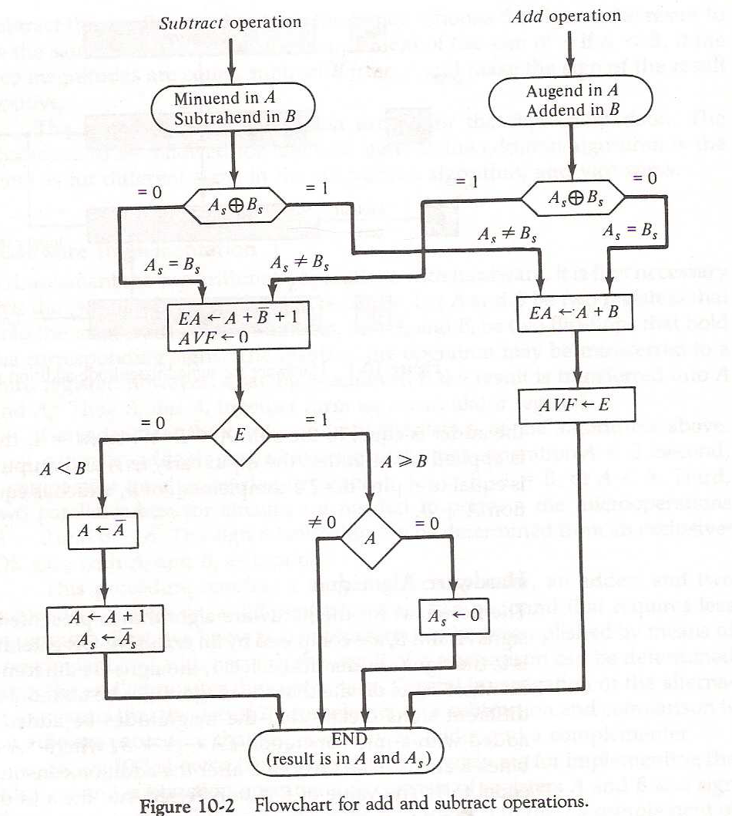
Flow Chart for Signed Magnitude Addition & Subtraction

Slide 4
Hardware for Signed-2’s complement addition and subtraction
BR register
V
Complement and parallel adder
Overflow
AC register

Slide 5
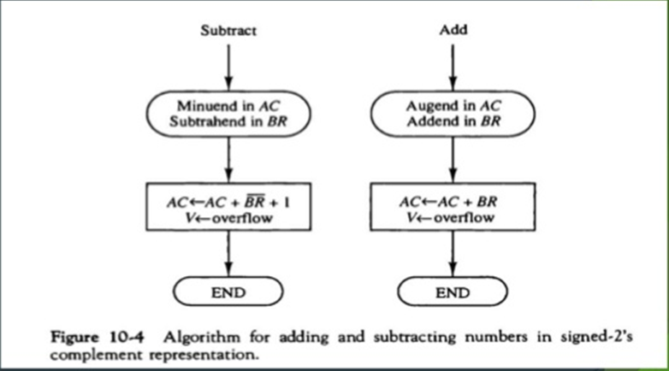
Algorithm for Signed-2’s complement addition and subtraction

Slide 6
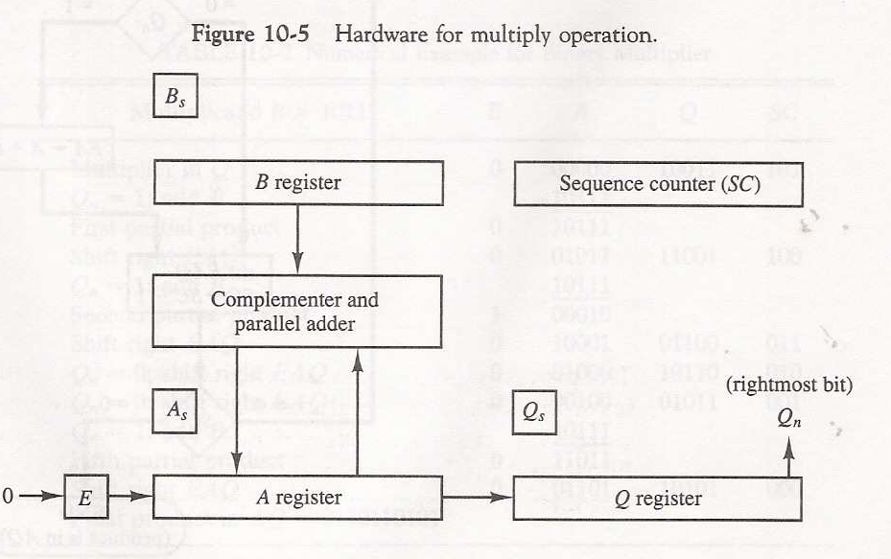
Hardware for Multiply operation (Signed-Magnitude data)

Slide 7
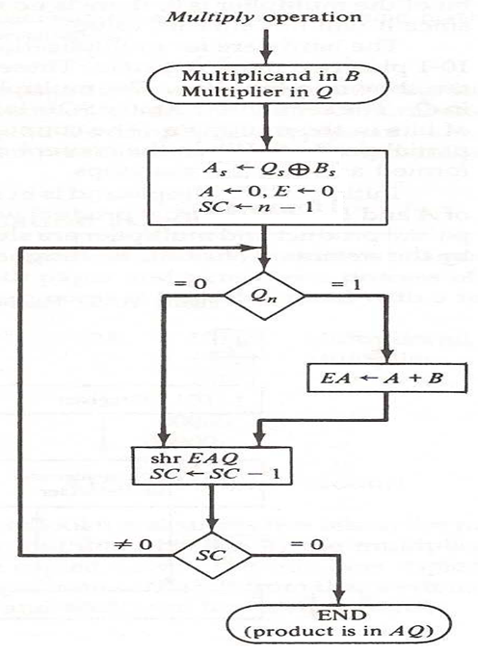
Flowchart for Multiply operation (Signed-Magnitude data)

Slide 8
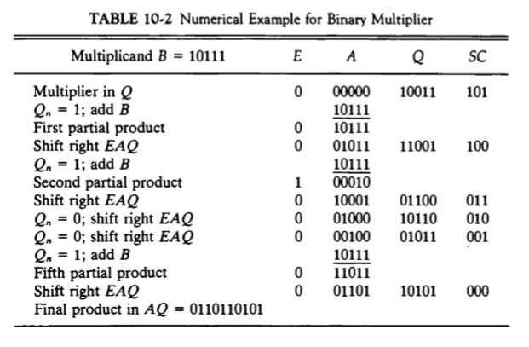
Example for Multiply operation (Signed-Magnitude data)

Slide 9
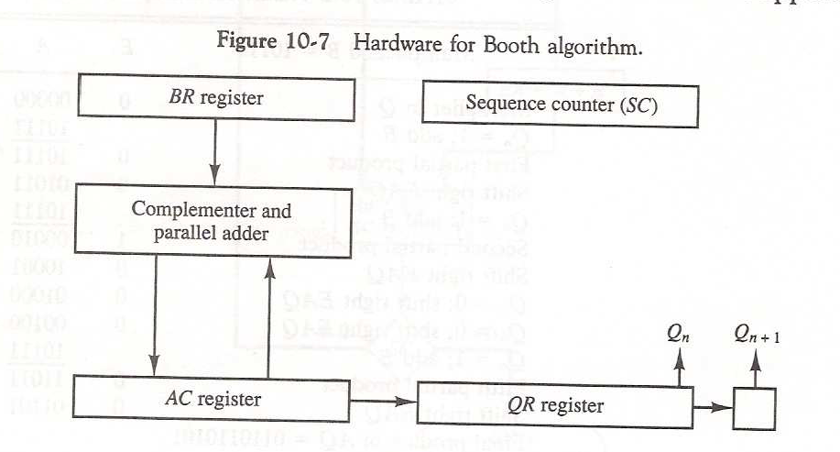
Hardware for Multiply operation (Signed-2’s Compliment)
Booth’s Algorithm

Slide 10
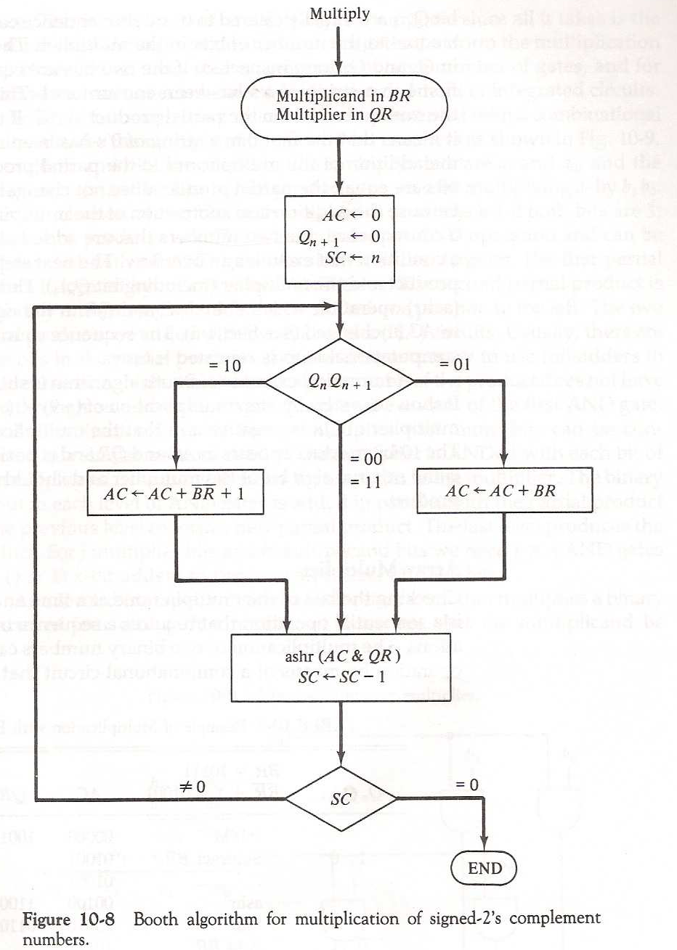
Flowchart for Multiply operation (Signed-2’s Compliment)
Booth’s Algorithm

Slide 11
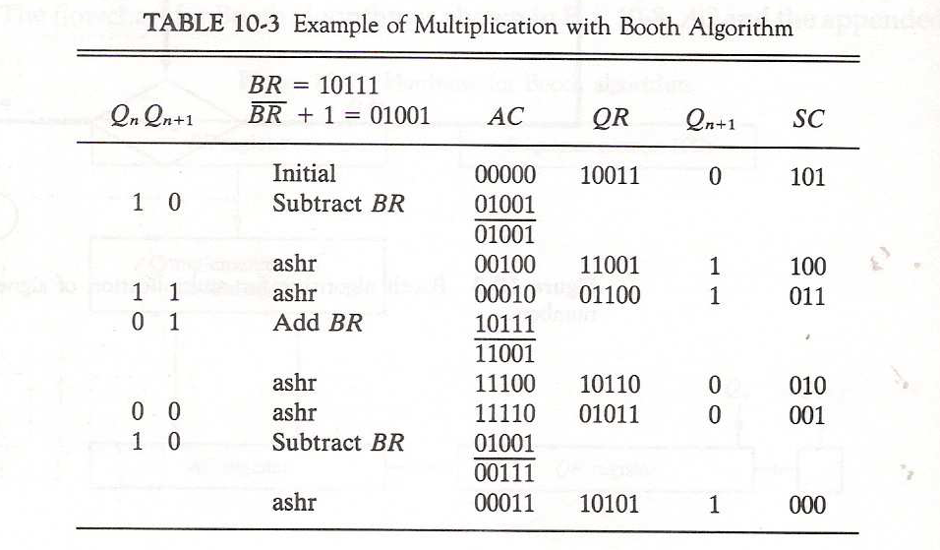

Slide 12
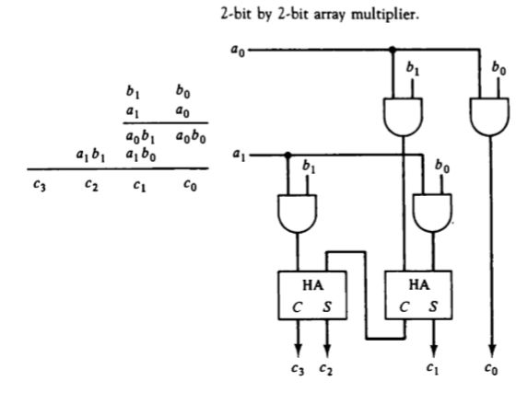
Array Multiplier

Slide 13
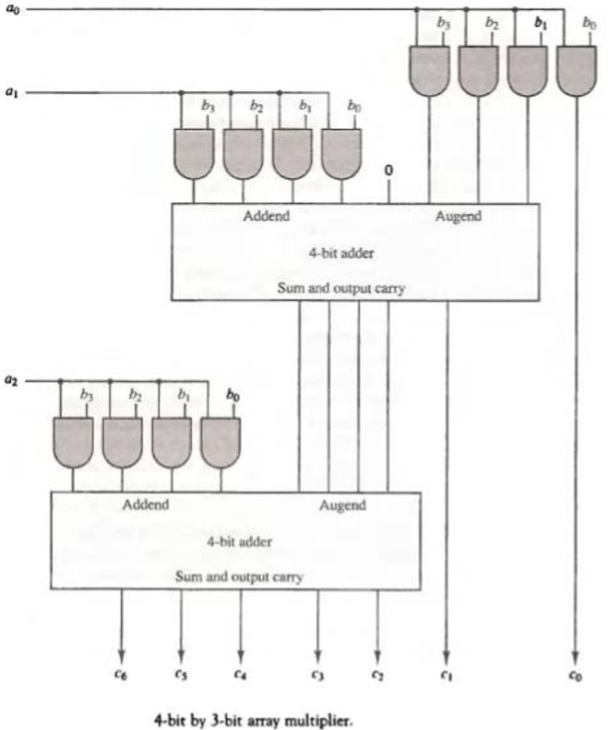
Array Multiplier

